Slide 1
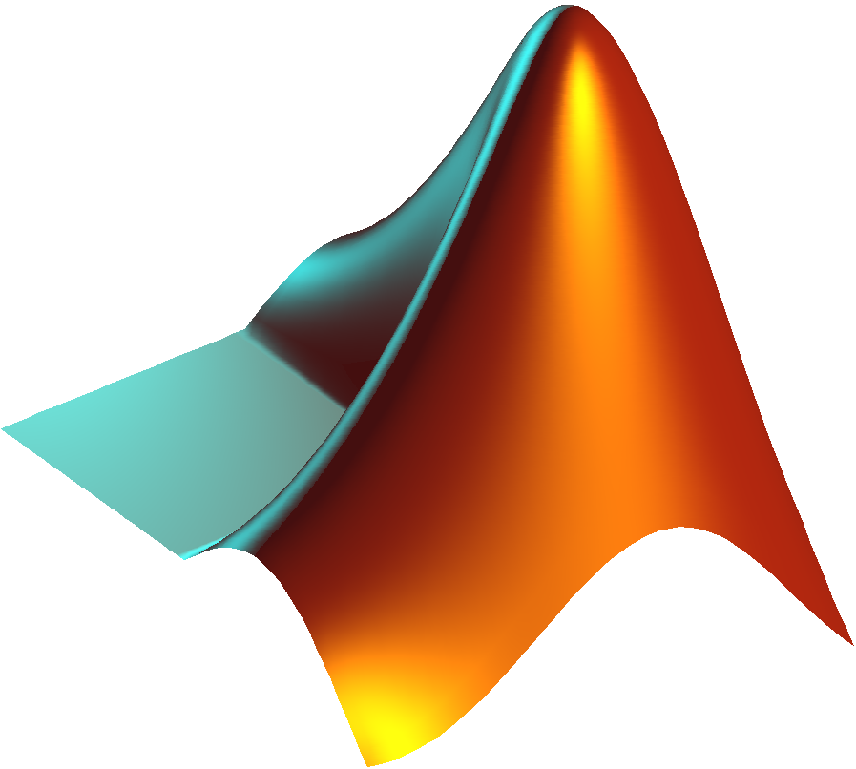
MATLAB Psychtoolbox 04
Tancy

Slide 2
Psychtoolbox Basics
Computers are perfect for creating and displaying visual psychophysics stimuli
Programs usually written in a low-level language (e.g. C or Pascal) to achieve full control of the hardware for precise stimulus display but are difficult to program
Interpreted languages like Matlab are abstracted from hardware details and provide friendlier development environments
The Psychophysics Toolbox is a software package that allows Matlab to fully control the hardware for precise stimulus display while retaining the flexibility and ease of Matlab.
Brainard, D. H. (1997) The Psychophysics Toolbox, Spatial Vision 10:433-436
Notes:
Zeros(size(my_mat))

Slide 3
Install Psychtoolbox (PTB)
http://psychtoolbox.org/
Following the instruction
Setpath
Test your PTB
PsychtoolboxVersion
Useful webpage
http://docs.psychtoolbox.org/Psychtoolbox

Slide 4
Before you start
Screen is the heart of PTB
ScreenTest
Screen()

Slide 5
The Screen command
>> help Screen
Screen is a MEX file for precise control of the video display. Screen has
many functions; type "Screen" for a list:
Screen
For explanation of any particular screen function, just add a question
mark "?". E.g. for 'OpenWindow', try either of these equivalent forms:
Screen('OpenWindow?')
Screen OpenWindow?
All the Screen Preference settings are documented together:
Screen Preference?
MEX = "Matlab Executable"
A file written in another language like C that can be called as a Matlab function

Slide 6
"windowPtr" argument: Screen 'OpenWindow' and 'OpenOffscreenWindow' both return a windowPtr, a number that designates the window you just created. You can create many windows. To use a window, you pass its windowPtr to the Screen function you want to apply to that window.
"rect" argument: "rect" is a 1x4 matrix containing the coordinates of an imaginary box containing all the pixels. All screen and window coordinates follow Apple Macintosh conventions. Coordinates can be local to the window (i.e. 0,0 origin
is at upper left of window), or local to the screen (origin at upper left
of screen), or "global", which follows Apple's convention of treating the
entire desktop (all your screens) as one big screen, with the origin at
upper left of the main screen, which has the menu bar.

Slide 7
The Screen command
>> Screen DrawLine?
Usage:
Screen('DrawLine', windowPtr [,color], fromH, fromV, toH, toV [,penWidth]);
Draw a line. "color" is the clut index (scalar or [r g b a] vector) that you
want to poke into each pixel; default produces black. "fromH" and "fromV" are
the starting x and y positions, respectively. "toH" and "toV" are the ending x
and y positions, respectively. Default "penWidth" is 1.
See also: DrawLines

Slide 8
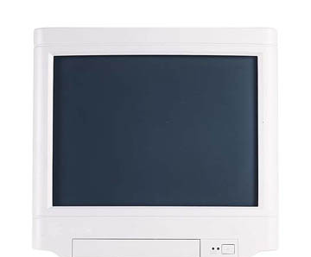
Screen drawing and psychtoolbox
Origin
Screen Geometry
Coordinates are
measured in pixels.
X ----------- Positive ->
Y
Positive
Max X and Y

Slide 9
How you typically work with the psychtoolbox
Back Buffer
(invisible)
Front Buffer

Slide 10
How you typically work with the psychtoolbox
Step 1: Draw
Shape to the back buffer
Front Buffer

Slide 11
How you typically work with the psychtoolbox
Step 2:
Flip the back buffer
to the front buffer

Slide 12
How you typically work with the psychtoolbox
Back Buffer is automatically cleared

Slide 13
How you typically work with the psychtoolbox
Now you can continue with your next frame of animation

Slide 14
How you typically work with the psychtoolbox
Flip the back buffer
to the front buffer

Slide 15
How you typically work with the psychtoolbox
Back Buffer is automatically cleared

Slide 16
Whenever you draw to the screen in PTB, you are drawing to the back buffer
You will not see anything you've drawn until you "Flip" the buffers
This separates drawing and arranging time from presentation time – you can wait until the precise moment you want everything to appear and pull the trigger (Flip)

Slide 17
Opening the screen
[windowPtr,rect]=Screen('OpenWindow',ScreenNumber)
returns a number that we will use to refer to this screen in future commands
which screen you want to open (you may have multiple monitors)
returns a rectangle (a vector of four numbers) that describe the dimensions of the screen

Slide 18
[windowPtr,rect]=Screen('OpenWindow',ScreenNumber)
Slight OS difference here!
For all platform differences, see http://psychtoolbox.org/PlatformDifferences
>> Screen('Screens')
MAC OS X:
0 is the main display (with the menubar) and 1 is the first external display
WINDOWS:
0 refers to all displays together, then 1 is the main monitor and 2-x are externals
>> max(Screen('Screens'))

Slide 19
[windowPtr,rect]=Screen('OpenWindow',ScreenNumber)
rect =
0 0 1680 1050
width
height
(0,0)
x
y
(1680,1050)

Slide 20
Using Screen
function drawSomething()
[wPtr, rect
] = Screen('OpenWindow',max(Screen('Screens'))); %open the screen
Screen('FillRect', wPtr, [255 0 0],[100 100 500 500]); %draw a rectangle on the back buffer
Screen('Flip',wPtr); %flip the buffers
KbWait(); color rect %wait until key pressed
clear Screen;
end

Slide 21
Basic Display Loop in PsychToolbox (PTB)
% Open Window
% while some condition is true do the following
% draw something
% make some changes
% repeat
% Close screen

Slide 22
Task 1: Basic Display Loop in PTB (code)
draw_stuff.m

Slide 23
Moving Shapes around the Screen
Shapes are defined by an array of numbers e.g. sh1 = [10, 15, 40, 45] ; % [x1, y1, x2, y2]
To move a shape in the x direction by 5 pixels we need to increment both x coordinates by 5 e.g. sh1(1) = sh1(1) +5; sh1(3) = sh1(3) +5 or use another array: sh1 = sh1 + [5, 0, 5, 0];
Same for moving in the y direction
Increment both if you want to move diagonally

Slide 24
Task 2
Make the rectangle move to the bottom of the screen at 5 pixels per frame, then move right when it hits the bottom.
When it hits the right, the program ends
Hint: shape_dimensions(1) is x1, (2) is y1, (3) is x2, (4) is y2

Slide 25
Task 3
When the rectangle hits the bottom make it change colors to red
Hint: color is a 3 number vector red is [255, 0, 0]

